Slide 1
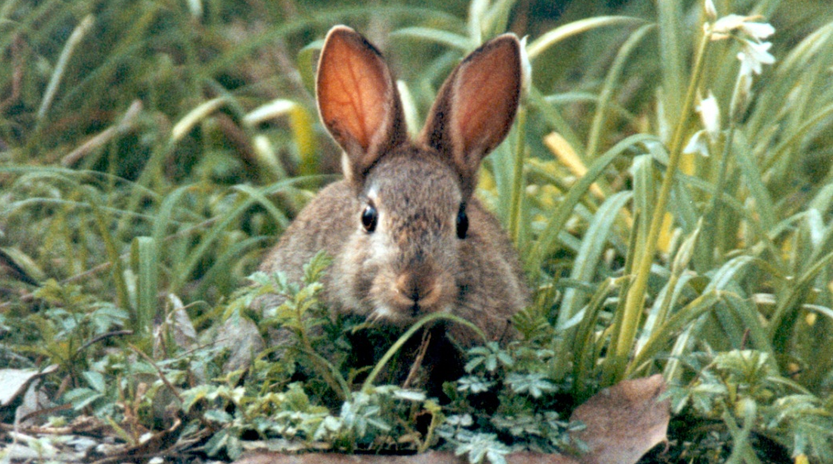
Rabbit Management
Community Capacity Building Participation
Shawna Dominelli - Weeds and Pests Officer

Slide 2
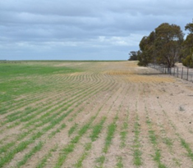
Overview and Agenda
Why control rabbits?
Key aspects of rabbit biology for management
Victorian Rabbit Action Network (VRAN)
Integrated Pest Management (IPM) & best practice rabbit control
Legislation, permits and other constraints
Rabbit impact and monitoring
Rabbit warren fumigation demonstration
Bait station demonstration
Summary and evaluation

Slide 3
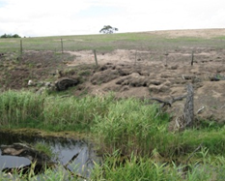
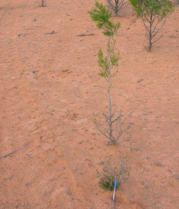
Why control rabbits?
Rabbits are one of Australia’s worst pests
Rabbits are widespread and established in Victoria and beyond eradication. Rabbit control should focus on managing the impacts of rabbits on agriculture and the environment.
Rabbits cost Australian agriculture $206m a year & eat farm profits
Rabbits cause erosion
Rabbits degrade creeks and rivers
Rabbits threaten native plants and just 1 rabbit / ha can stop regeneration
Rabbits are food for other pest animals
Myxomatosis & Rabbit Haemorrhagic Disease Virus have saved Australia’s pastoral industries an estimated $70 billion over the last 60 years (Cooke et al. 2013)

Slide 4
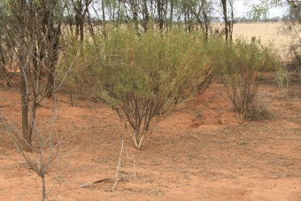
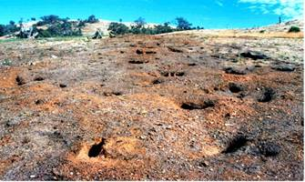
Ethical responsibility
As land managers we are the custodians of the land and must look after our country for our children and the plants and animals we share it with
As community members we have a responsibility to work together with our neighbours towards shared goals; be it community safety or protecting agriculture and the environment from the impacts of rabbits

Slide 5
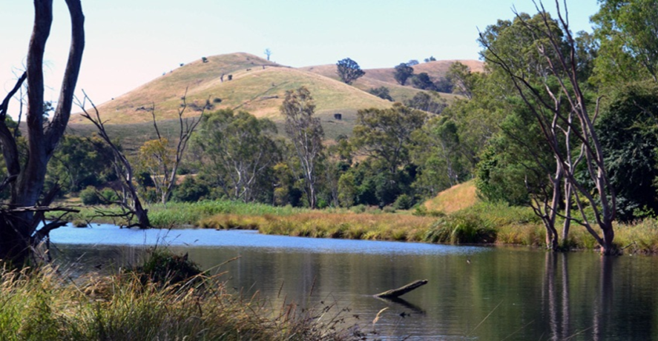
Catchment and Land Protection Act 1994 (CaLP)
Legislative Environment
Key Sections to the CaLP act
Part Three - Duties of the Secretary and Landowners
S. 20(1)(f) In relation to his or her land a landowner must take all reasonable steps to prevent the spread of, as far possible, eradicate established pests.

Slide 6
Focus Area and Control Timelines
A coordinated community led effort to manage rabbits
Integrated management
Maximum resources in year 1
Begin control in late summer/early autumn
Bait (where possible) prior to ripping
Remove harbour and destroy warrens
Erect exclusion fencing
Follow up with fumigation
Persistence and ongoing monitoring
Evaluate success
Work together

Slide 7
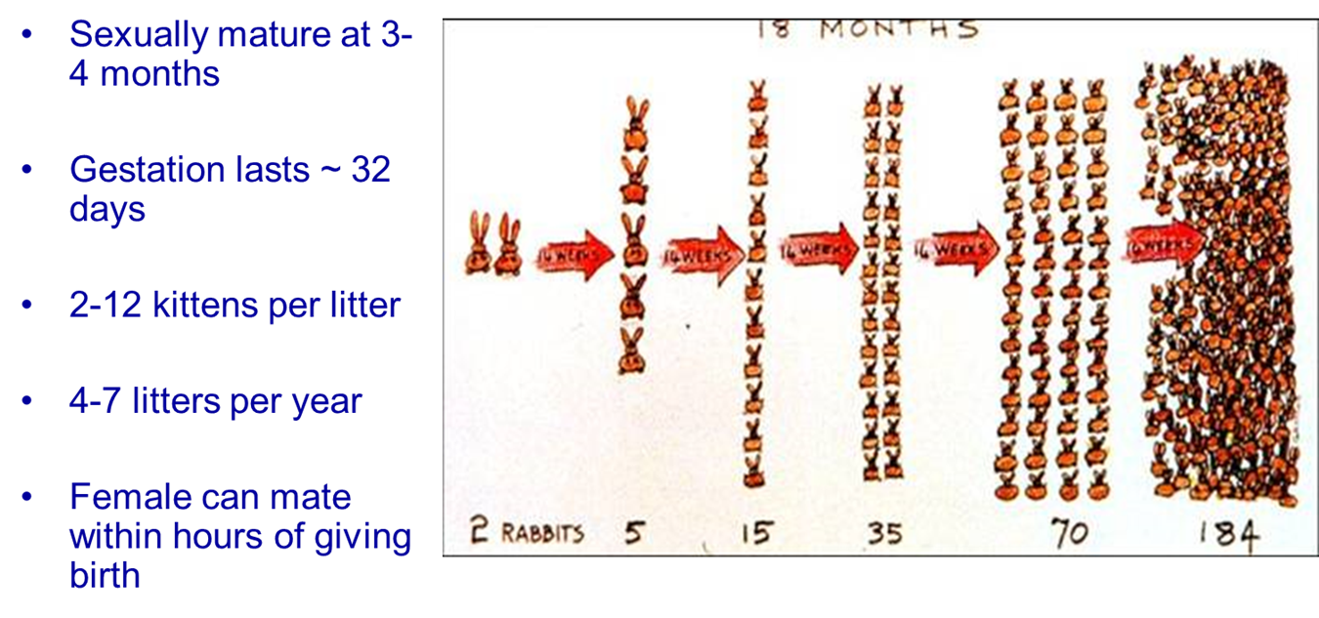
Rabbit Biology
Gestation: 28 - 30 days
Weaning: fully independent at 21 - 25 days
Mating: 3 - 4 months
Litter size: 4 - 6 per litter (up to 10). ~28 kittens per year
Breeding: seasonally when green feed is available.
Can re-mate ½ - 2 hours after giving birth

Slide 8
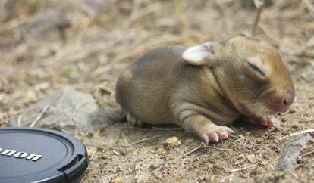
Rabbit Biology continued
Adult weight: ~ 1.6 kg
Life span: 1.5 – 2 years in the wild
Survival: Only 5-10% of juveniles survive to breed
Daily water intake: 0 - 100 mL. Can exist in very dry conditions meeting their water demands from plants
Rabbits are highly selective grazers removing the best quality feed.
Daily feed intake: 150 - 500 g. ~ 9 rabbits = 1 D.S.E.
Coprophagic: Eat faeces from their anus to maximise nutrients

Slide 9
Rabbit Biology continued
Rabbits are territorial and have a social hierarchy during breeding season
Activity: above ground 6-14 hours; dusk observation 42-66% of rabbits
Home range: 0.2 ha for temperate to 3.7 ha for semi-arid areas. Larger for males than females.
Dispersal: 1.5 – 20 (rare) km. Males (36-72%) more commonly disperse than females (8-30%).
Rabbits are neophobic (scared of new things) hence the need for free feeding
Rabbits are poor thermo-regulators therefore they need shelter such as warrens or harbour to avoid extremes of hot and cold.
Habitat: the warren is the rabbit’s Achilles heel. Destroy the warren and you will destroy the rabbit.

Slide 10
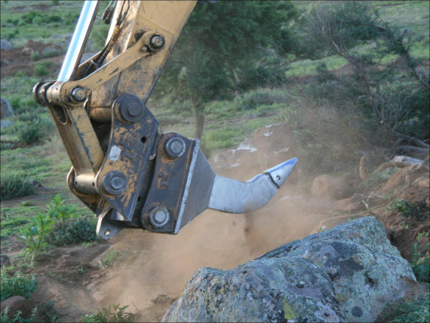
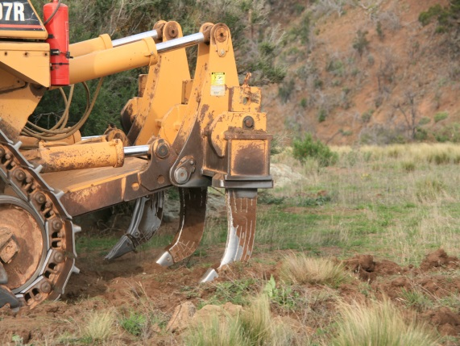
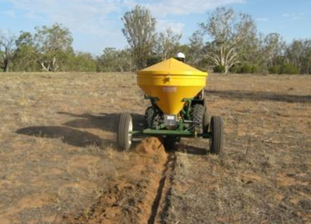
Management Implications
Due to fast reproductive biology we must reduce rabbit populations by about 95% to achieve long term control
Rabbits at low densities (1-2 per ha) can substantially impact on the regeneration of native seedlings
Baiting should be carried out in the summer when feed is limited in rabbit feeding areas
Due to localised nature of dispersal it is important to destroy or treat all warrens within the project area and for rabbit management to be coordinated at the landscape scale

Slide 12
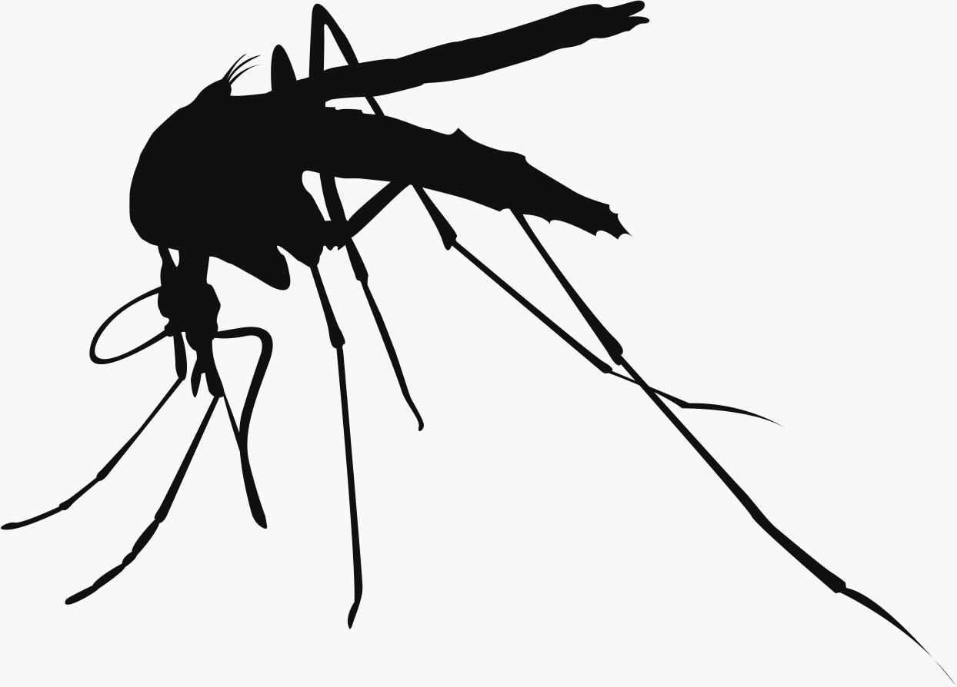
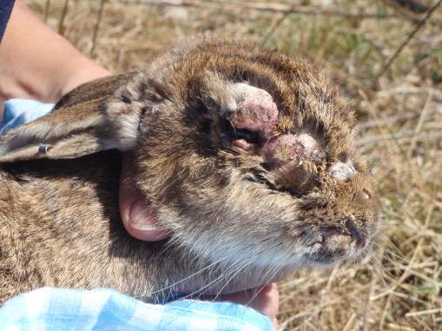
Biological Control
Myxomatosis is a virus spread between live rabbits via biting insects such as mosquitoes and fleas
Causes lumps around face and genitals, loss of appetite, fever and death
Introduced in 1950’s, virulent strains caused death 8-15 days after infection with 100% mortality.
Presently the less virulent field strains infect rabbits for around 30 days with only 40-60% mortality.
For rabbits infected with the most attenuated (weak) field strains almost all survive.
Rabbits that survive the disease are immune for life.

Slide 13
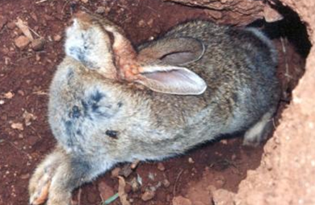
Biological Control - RHD
Rabbit haemorrhagic disease (RHD) also known as calicivirus is spread through direct contact with infected rabbits, carcass’ or carriers such as flies and fleas.
RHD was released in Australia in 1996 and caused a 90% reduction in rabbit numbers.
Currently has reduced effectiveness due to resistance.
A new strain of RHD named RHDV1 K5 found to naturally occur in Korea is planned to be released in Australia in 2017.
RHDV1 K5 kills more rabbits and is a faster death than the current strain of RHD

Slide 14
RHDV1 K5
Initial release 150 sites across the state – March 2017 – reduction in national rabbit population of 42%
Not a new virus - rather a variant of RHDV1
Available for purchase from EMAI – NSW
alison.jugow@dpi.nsw.gov.au
Cost of $120 plus postage
No restrictions on its use in Victoria

Slide 15
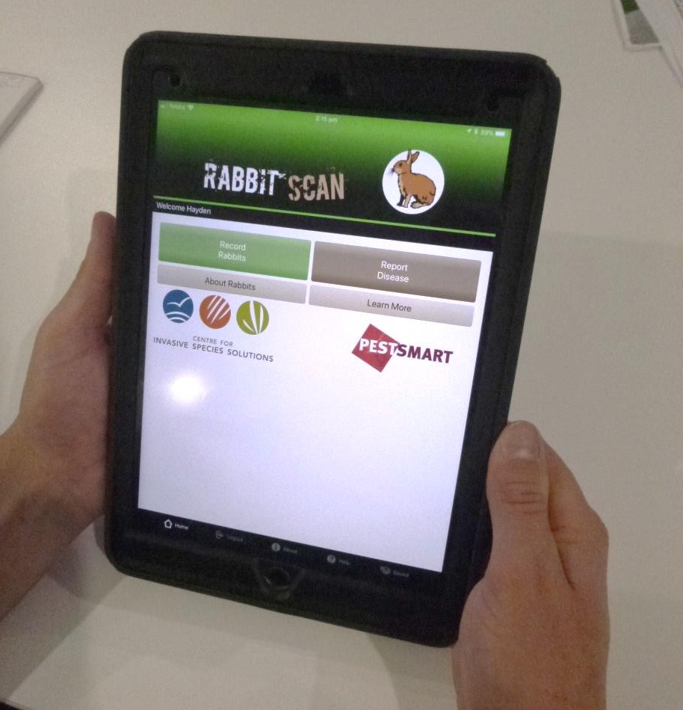
Feral Scan App
Record rabbit sightings and damage
Record control methods used
Record rabbit deaths and possible disease
View data on rabbit deaths
Order free sample kits

Slide 16
Victorian Rabbit Action Network (VRAN)
Community Pest Management Groups (CPMGs) established in 2014 – Promote community led action on rabbit management
Made up of community members who have a stake in controlling the impact of rabbits.
Funding opportunities available for rabbit control.
Further information: https://rabbitaction.com/

Slide 17
Funding Opportunities
National Landcare Program Enviro small grants (Aust Govt)
https://www.business.gov.au/assistance/national-landcare-program-environment-small-grants

Slide 18
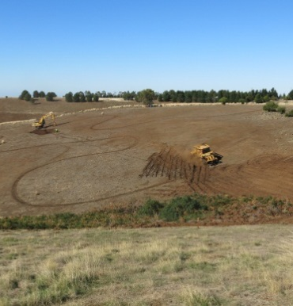
Integrated Pest Management (IPM)
Best Practice Rabbit Control
IPM is a science based approach that uses a range of control methods for the effective long term control of pest animals and reduction of their harmful impacts.
Best practice is the timely application
of the right techniques to the required
standard.
Best practice rabbit control is humane,
efficient and effective.
For best results control works on
adjoining properties should be
coordinated to occur at the same time.

Slide 19
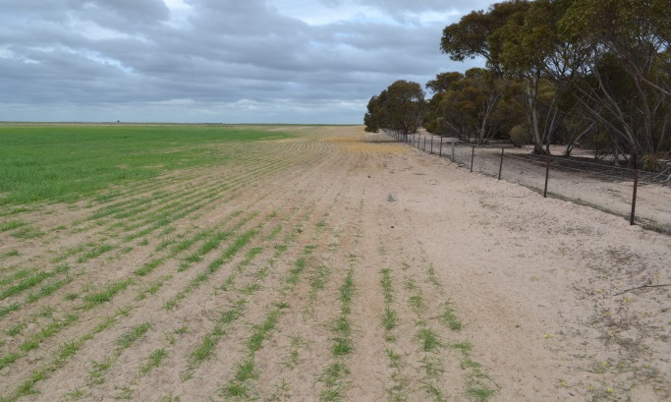
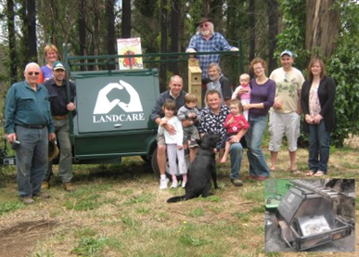
Importance of Coordination
Rabbits don’t stop at property boundaries
Rabbits reinfest from surrounding areas
Effective long term control requires coordinated warren destruction at the landscape scale
Sharing specialised equipment, contractors, labour and material can make rabbit control cheaper, more efficient, more effective and more enjoyable!
The larger the area under long term rabbit control the more resistant it will be to re-invasion and re-infestation.

Slide 20
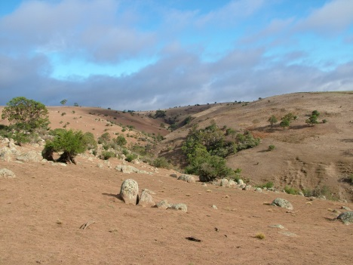
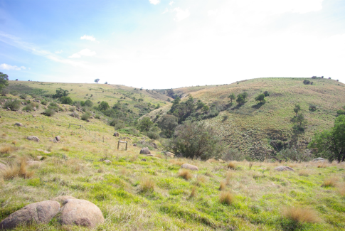
Planning Control
Effective pest management programs must have a plan with specific aims and objectives, a project timeline, monitoring and evaluation strategies.
Rabbit control is not about the number of dead rabbits its about protecting vulnerable agricultural and environmental assets from rabbits.
DEDJTR uses warren entrance counts as their primary monitoring tool.
This threshold that protects vulnerable plant species and provides effective long term rabbit control.

Slide 21
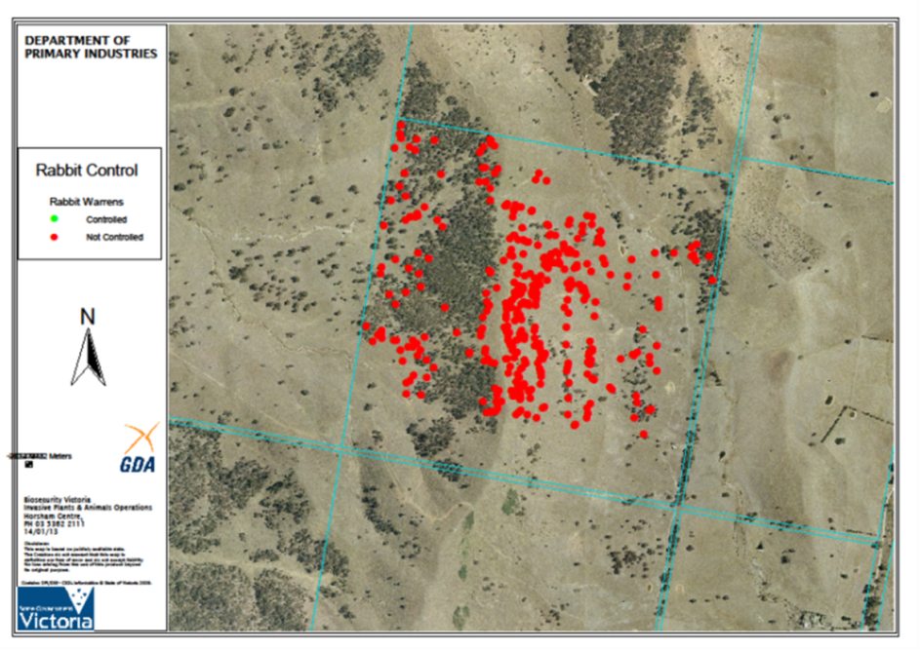
Mapping
Mapping rabbit warrens using GPS is a crucial monitoring and
management tool
Rabbits will usually return to the
same places in the landscape to
dig warrens
Accurate maps allow you to effectively plan, implement control and conduct follow up treatment and monitoring
Maps can also be used to demonstrate project success / change over time
There are many free smartphone GPS apps and mapping tools available online

Slide 22
Timing Rabbit Control
There is a right and a wrong time to implement rabbit control
The best time to control rabbits is the NON-BREEDING SEASON because:
Controlling when numbers are at their greatest leaves a higher residual population compared to controlling rabbits at their lowest.
Control in late summer early autumn after disease such as RHD and Myxomatosis have taken effect.
Feed is limited making baits more attractive.
Vegetation is reduced and bait trails are more accessible to rabbits.
Young rabbits are feeding further away from the warren.
Soils are more friable and warrens tend to collapse more readily when ripped by heavy machinery.
After warrens are destroyed rabbit survival is constrained by extremes of climate and predation.

Slide 23
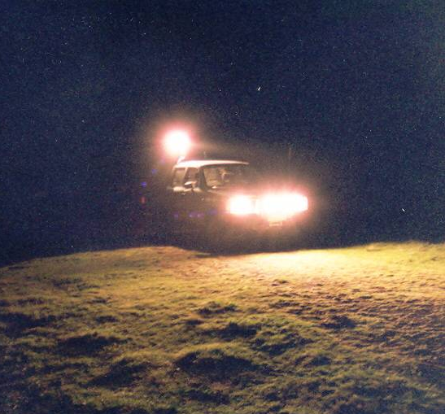
Monitoring - assessing rabbit numbers
Methods:
Spotlight transects with a vehicle
Walked transects
Warren monitoring
Vegetation impact assessment
Monitoring:
Triggers action
Leads to better planning, evaluation
and decision making
Rabbit population estimates based on night or
day time observations are highly variable and
often underestimate rabbit densities.

Slide 24
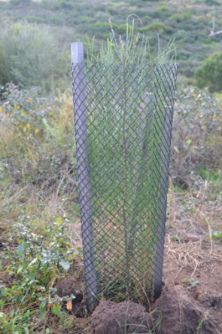
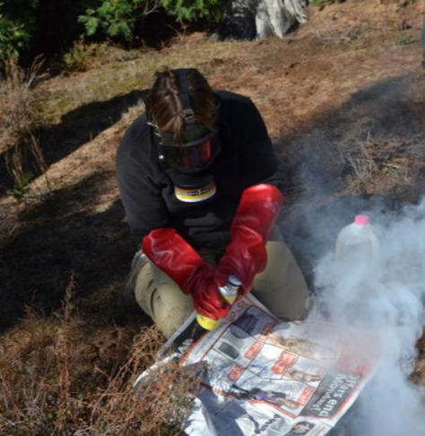
Monitoring / Follow up
Use monitoring to:
Decide what control is required
Trigger control effort
Assess the effectiveness of you control measures
Modify your rabbit control plan
Remember:
Rabbit control is an ongoing task – remain vigilant
Rabbit control should be part of integrated land management
Rabbit control is most effective when numbers are low
The warren is the key to the rabbits ability to rebound and establish

Slide 25
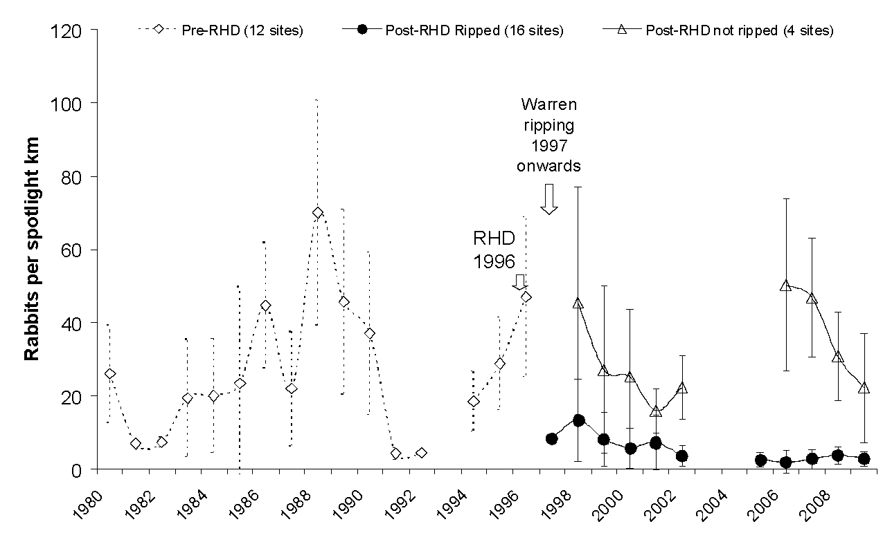
Monitoring Results
Long term impact on warren ripping

Slide 26
Ararat Long Term Monitoring
Annual monitoring since 1998, warren ripping from 200-2002
(100% warrens ripped)
Pre-RHDV = 79 Rabbits/km (1996)
Post-RHDV + Ripping = 6.2/km (2018)
= 91% Decrease in rabbit numbers
Pre-RHDV = 191 Warren entrances/ha
Post-RHDV + Ripping= 14.7/ha
= 92% Decrease in rabbit warrens
= 15 Years of sustained (90%>) Long term rabbit control

Slide 27
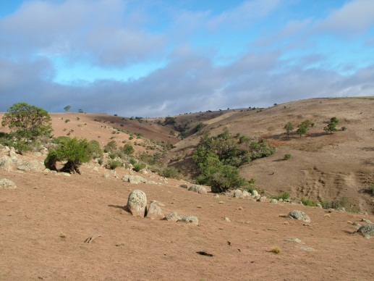
Before
After

Slide 28
Baiting
Restrictions on the use of 1080 in urban areas - DO NOT use
ACUP not required for Pindone pre-mixed with oats/carrots
Bait availability
Keep chemical records and comply with legislation
DO NOT use Pindone in urban areas where residential blocks are less than 1,000 square metres
Follow manufacturers recommendations & Pindone DFU

Slide 29
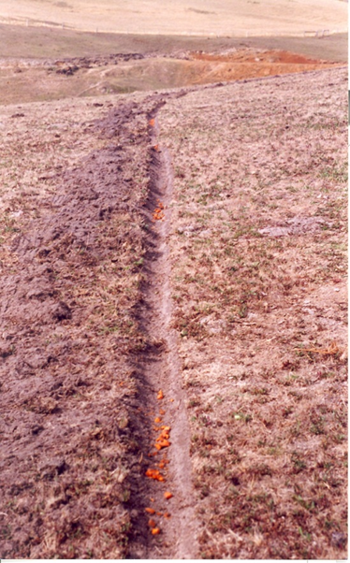
Baiting - continued
Timing- when grass has cured & after biocontrol
Initial knockdown technique – no long term control
Methods: trail baiting, bait stations or broadcast
Feeding behaviour and feed availability
Free feeds / rate / bait arrangement
Non target damage
Bait types: carrot vs oats

Slide 30
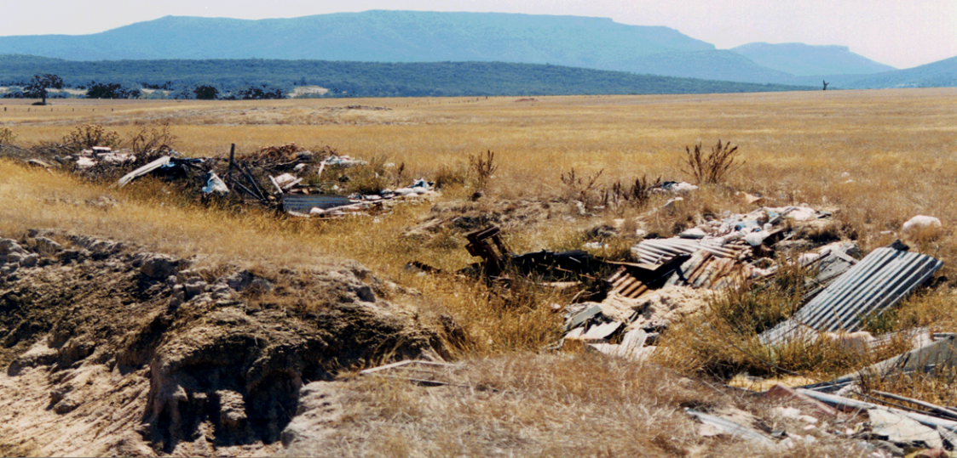
Harbour removal
Essential long term management tool
Trim under all hedges and thickets of scrub, remove low branches and destroy possible shelter.
Remove prickly and woody weeds (such as gorse, boxthorn and blackberries), rubbish piles and old machinery.Check laws governing native vegetation with local council
Ensure that if you are removing native fallen timber you do not affect native wildlife

Slide 31
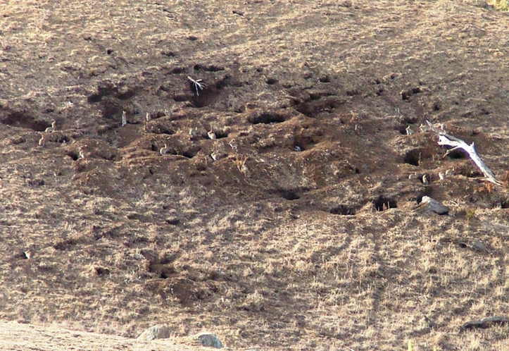
Harbour removal
Ensure you comply with local fire restrictions if burning piles of vegetation – Contact NGSC
Block up rabbit ‘runs’ or above ground thoroughfares
Make your land inhospitable to rabbits – be persistent!

Slide 32
Warren destruction
Key to long term rabbit control
Reduce rabbit numbers
Flush rabbits below ground
Use a spotter to ensure all entrances ripped 4m beyond each opening
Smaller backhoes and excavators can be useful for working around trees and where space is limited.
Contact Dial Before You Dig Ph: 1100 or www.1100.com.au
Rip, cross rip & backblade
Depth minimum 700 to 900 mm, rip lines < 500mm apart
Treat all warrens
Monitor and retreat re-openings
Warren ripping programmes have been very successful in reducing rabbit numbers by ~83% for up to 15 years

Slide 33
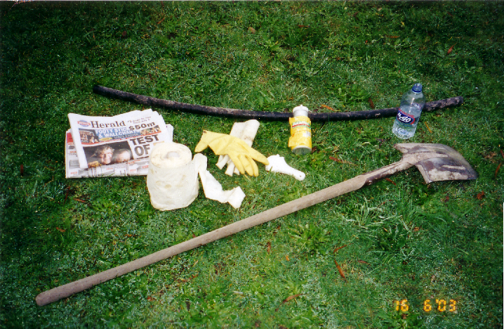
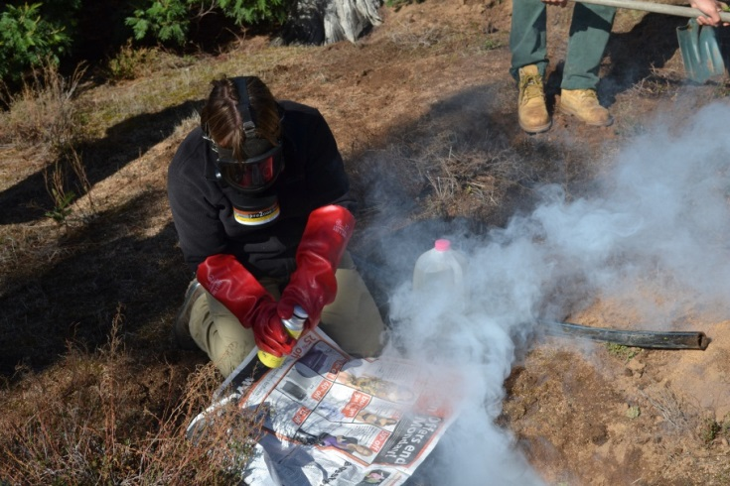
Fumigation
Re-opened warrens/low rabbit numbers
Flush all rabbits below ground
Clear surface harbour
Use a smoking device
Dig back all entrances, remove leaves, roots etc.
How aluminium phosphide works
Insert tablets into entrance
Moisten if required
Seal each entrance
Monitor and repeat
Safety – Specialised PPE, follow manufacturers recommendations
Legal requirements - ACUP

Slide 34
Exclusion Fencing
Fence off high value assets like shipping containers and shedding
Use ‘rabbit proof fencing’ specifically designed for rabbits
Mechanised trencher ‘Ditchwitch’ can be useful over long distances when burying fence
Ensure fence withstands livestock and native animal forces
Use sturdy posts driven at least 45 cm into the ground
Regular Maintenance – 20 year fence life

Slide 35
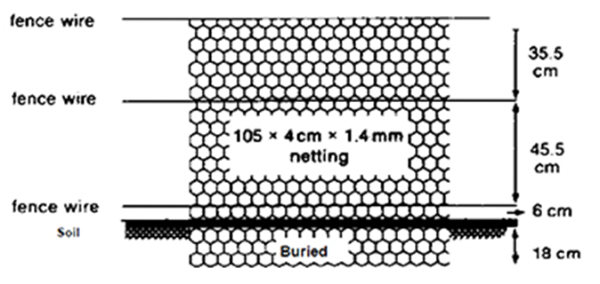
Exclusion fencing
Rabbit netting should be fixed so that it reaches at least 88 cm above the ground.
Where netting is buried, it should be buried to a minimum of 18 cm.
Where netting is bent to lay on the ground surface, it must be held down with pegs, rocks or timber.
Suitable rabbit-proof gates should be placed at all breaks in the fence.

Slide 36
Vegetation manipulation
Habitat manipulation – Vegetation undesirable to rabbits
New plantings – Consider plant species erect in stature less likely to harbour rabbits.
Conduct regular property maintenance.

Slide 37
Alternative management
The following management options may be beneficial in some situations:
Chemical repellents, not effective for long term rabbit control
Trapping, labour intensive and not effective for long term rabbit control
Tree guards, expensive and does not control rabbit numbers

Slide 38
Legislation and constraints
Planning rabbit management is easy….Right?
Legislation
Acts
Regulations
Policies and procedures
Operational constraints
Financial and political constraints
Social constraints

Slide 39
Agricultural and Veterinary Chemicals (Control of Use)
Act 1992
AKA: “Ag Vet and Chem Act”
Product labels = a legal document
1080 Directions for use
Chemical registrations
Record keeping
Transport and storage requirements
Authorisations to use
Restrictions of where some chemicals can be used. E.g. 1080 distance restrictions around waterways
What are the authorisations for 1080, Aluminium phosphide, Pindone?

Slide 40
Water Act 1989
The Water Act aims to protect waterways
To be considered before undertaking any works such as ripping or harbour removal around waterways which may impact the quality of that waterway
Prior to undertaking warren ripping around waterways, land owners must get a permit from the relevant CMA

Slide 41
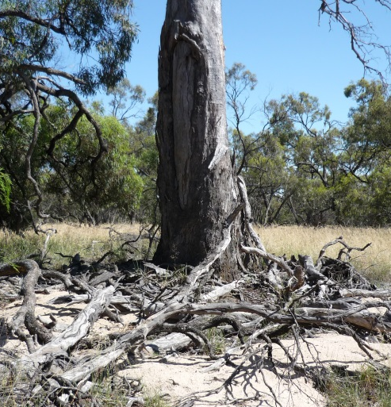
Areas of sensitivity
Incorporate sites of:
Archaeological significance
Historical significance
Aboriginal artefacts and places.
Can prevent ripping and fumigation in some areas.
Cultural Heritage Act (1995) & Aboriginal Heritage Act (2006) set requirements for cultural heritage assessments and management plans.

Slide 42
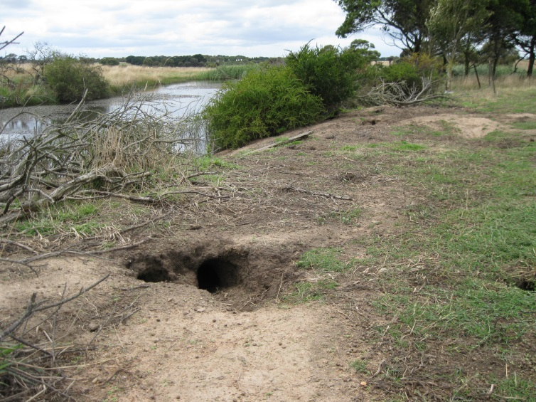
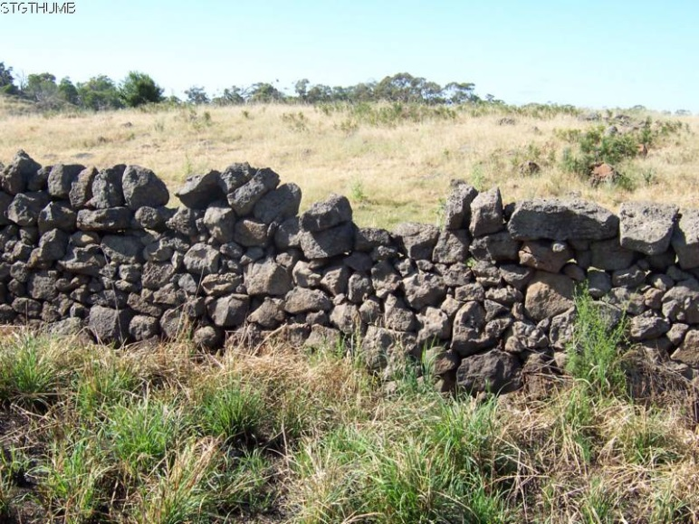
Areas of sensitivity
Maps available at: www.dpc.vic.gov.au/index.php/aboriginal-affairs/heritage-tools/areas-of-cultural-heritage-sensitivity
Reporting the discovery of Aboriginal places and objects is a legal requirement
Contact AAV and Registered Aboriginal Parties if planning rabbit control in a culturally significant area e.g. near any creek or river
If you have rabbits in a dry stone wall, cemetery or historic building you will need to contact Heritage Victoria

Slide 43
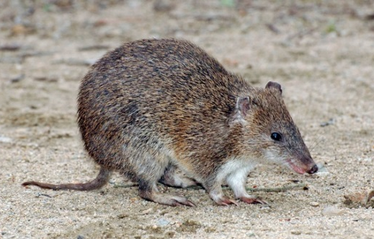
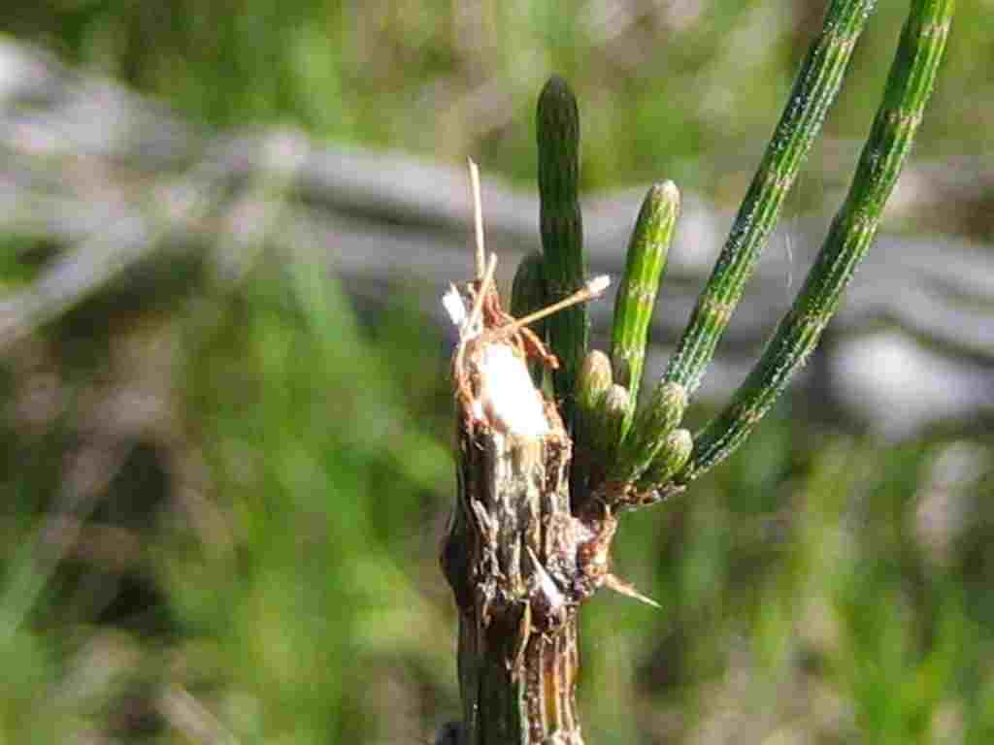
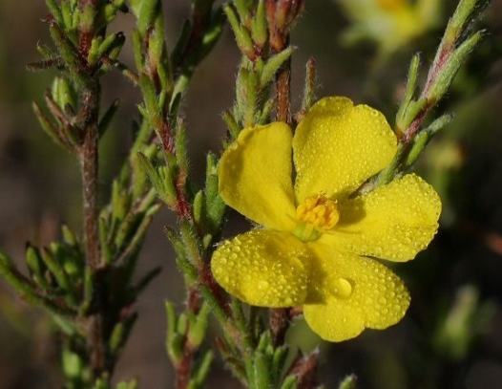
Flora and Fauna Guarantee Act 1988
Victorian legislation for the conservation of threatened species and communities and for the management of potentially threatening processes.
Varying levels of protection for listed native taxa and strategies to ensure they can survive, flourish and retain their potential for evolutionary development in the wild
Rabbit control works must not impact on listed taxa e.g. bandicoots or threatened vegetation communities
Exemptions available for some wildlife and native vegetation

Slide 44
Planning and Environment Act 1987
Framework for planning land protection, development and use.
Permits are required for native vegetation removal, exemptions exist in some areas if the removal is to assist with rabbit management.
Check with local council and obtain permission before removing native vegetation.

Slide 45
Land Act 1958
Land owners who hold a licence for a parcel of Crown are responsible for controlling pests on that land.
Rules for property boundaries around some waterways.
This can impact who has responsibility for invasive species management in riparian zones.

Slide 46
Prevention of Cruelty to Animals 1896 (POCTA)
Offence to commit an act of cruelty against an animal
An offence to poison an animal…
Unless in accordance with the CaLP Act, Wildlife Act 1975, or Drugs, Poisons and Controlled Substances Act 1982.
POCTA Regulations outline the requirements for traps:
Leghold traps
Confinement (cage) traps
POCTA also limits the use of dogs which must not attack, bite or maim rabbits
We all have an obligation to ensure that rabbit control is humane and that we minimise pain and suffering to rabbits

Slide 47
Review
What responsibilities does a landowner or leaseholder have to in relation to rabbits?
What should I do if planning rabbit control in the following situations:
Around shipping containers
In an area where essential services are located
Requiring the removal of native vegetation
Why is warren destruction so important for the long term management of rabbits?
What is the best time of year to manage rabbits? Why?
What is the recipe for effective long term rabbit control?
What should I do if I have questions or issues in relation to a community rabbit control project?

Slide 48
Thank you!

